Slide 1

NSG Pilkington – University of Liverpool Machine Learning Project: 30/06/2021
Dr. Peter Green
Diego Echeverria
Sarini Jayasinghe
Risk Institute,
School of Engineering

Slide 2
Today
Content:
Predictions with Uncertain Inputs
ISRA 5D
Next Steps
Upskilling:
Linear regression
How do we learn ‘online’?
What actually is a Neural Network?
What is a Gaussian Process?
How does PCA work?
Shannon Entropy

Slide 3
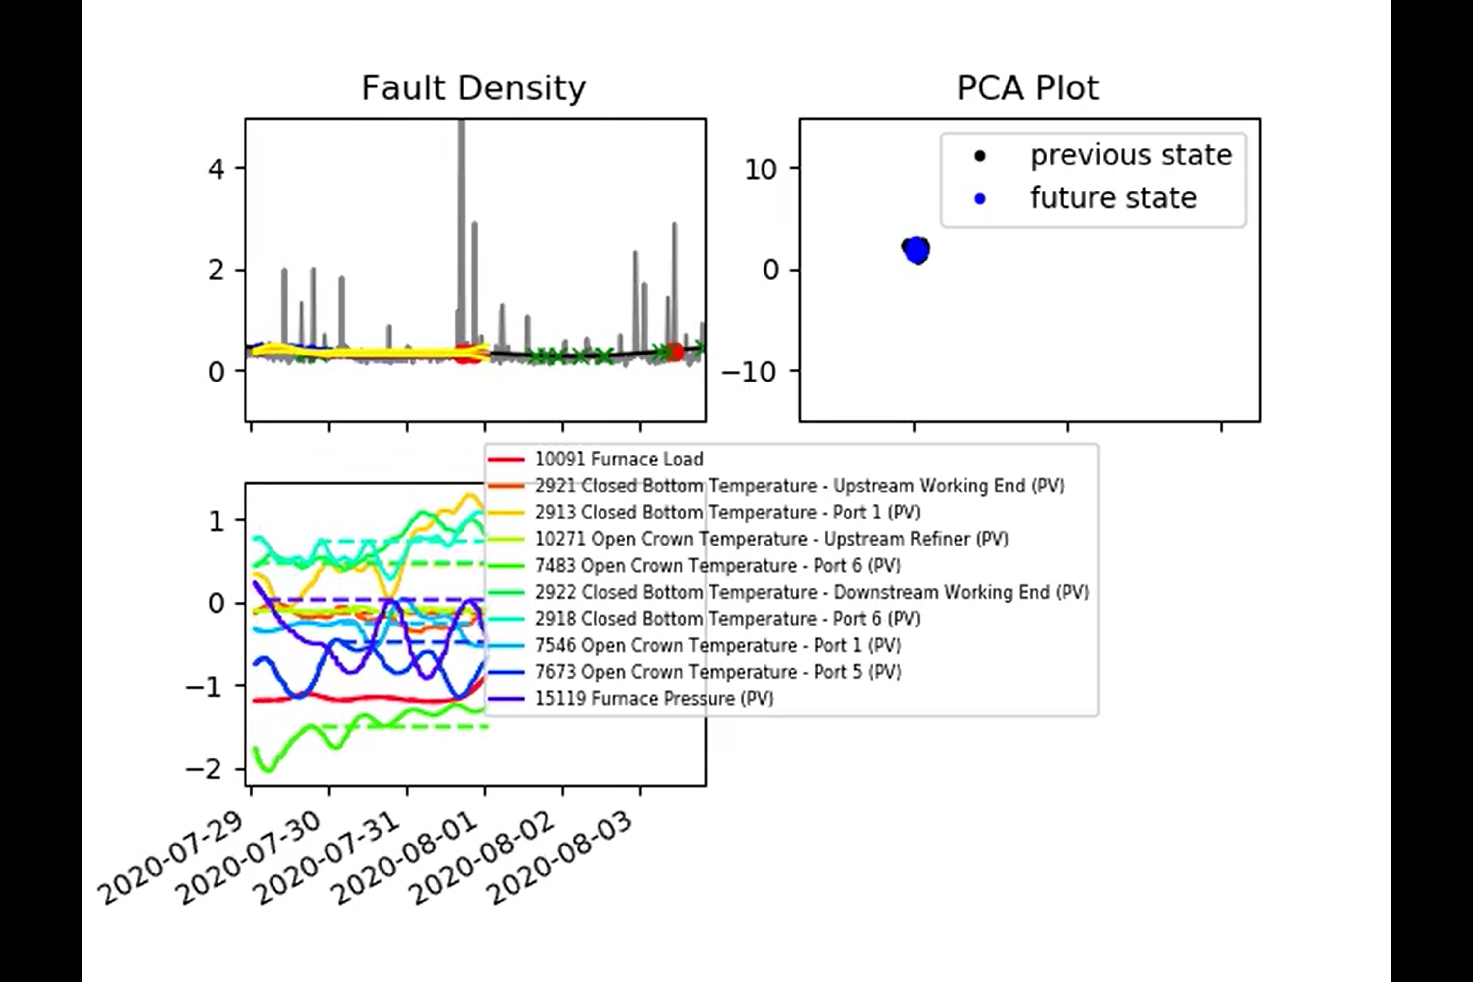
Predictions with Uncertain Inputs

Slide 4
Predictions with Uncertain Inputs
Here is where we transition from known input to ‘projected’ input.
Projected input is shown as a dashed line.
What really happened to the input is left as a solid line for now.

Slide 5
Predictions with Uncertain Inputs
Furnace Pressure PV has a time lag of 12 increments (4 hours).

Slide 6
Predictions with Uncertain Inputs
Open Crown Temperature Port 5 (PV) has a time lag of 72 time increments (24 hours).

Slide 7
Predictions with Uncertain Inputs
Furnace Load (and cullet ratio) are assumed known.
Anything else that should be included?

Slide 8
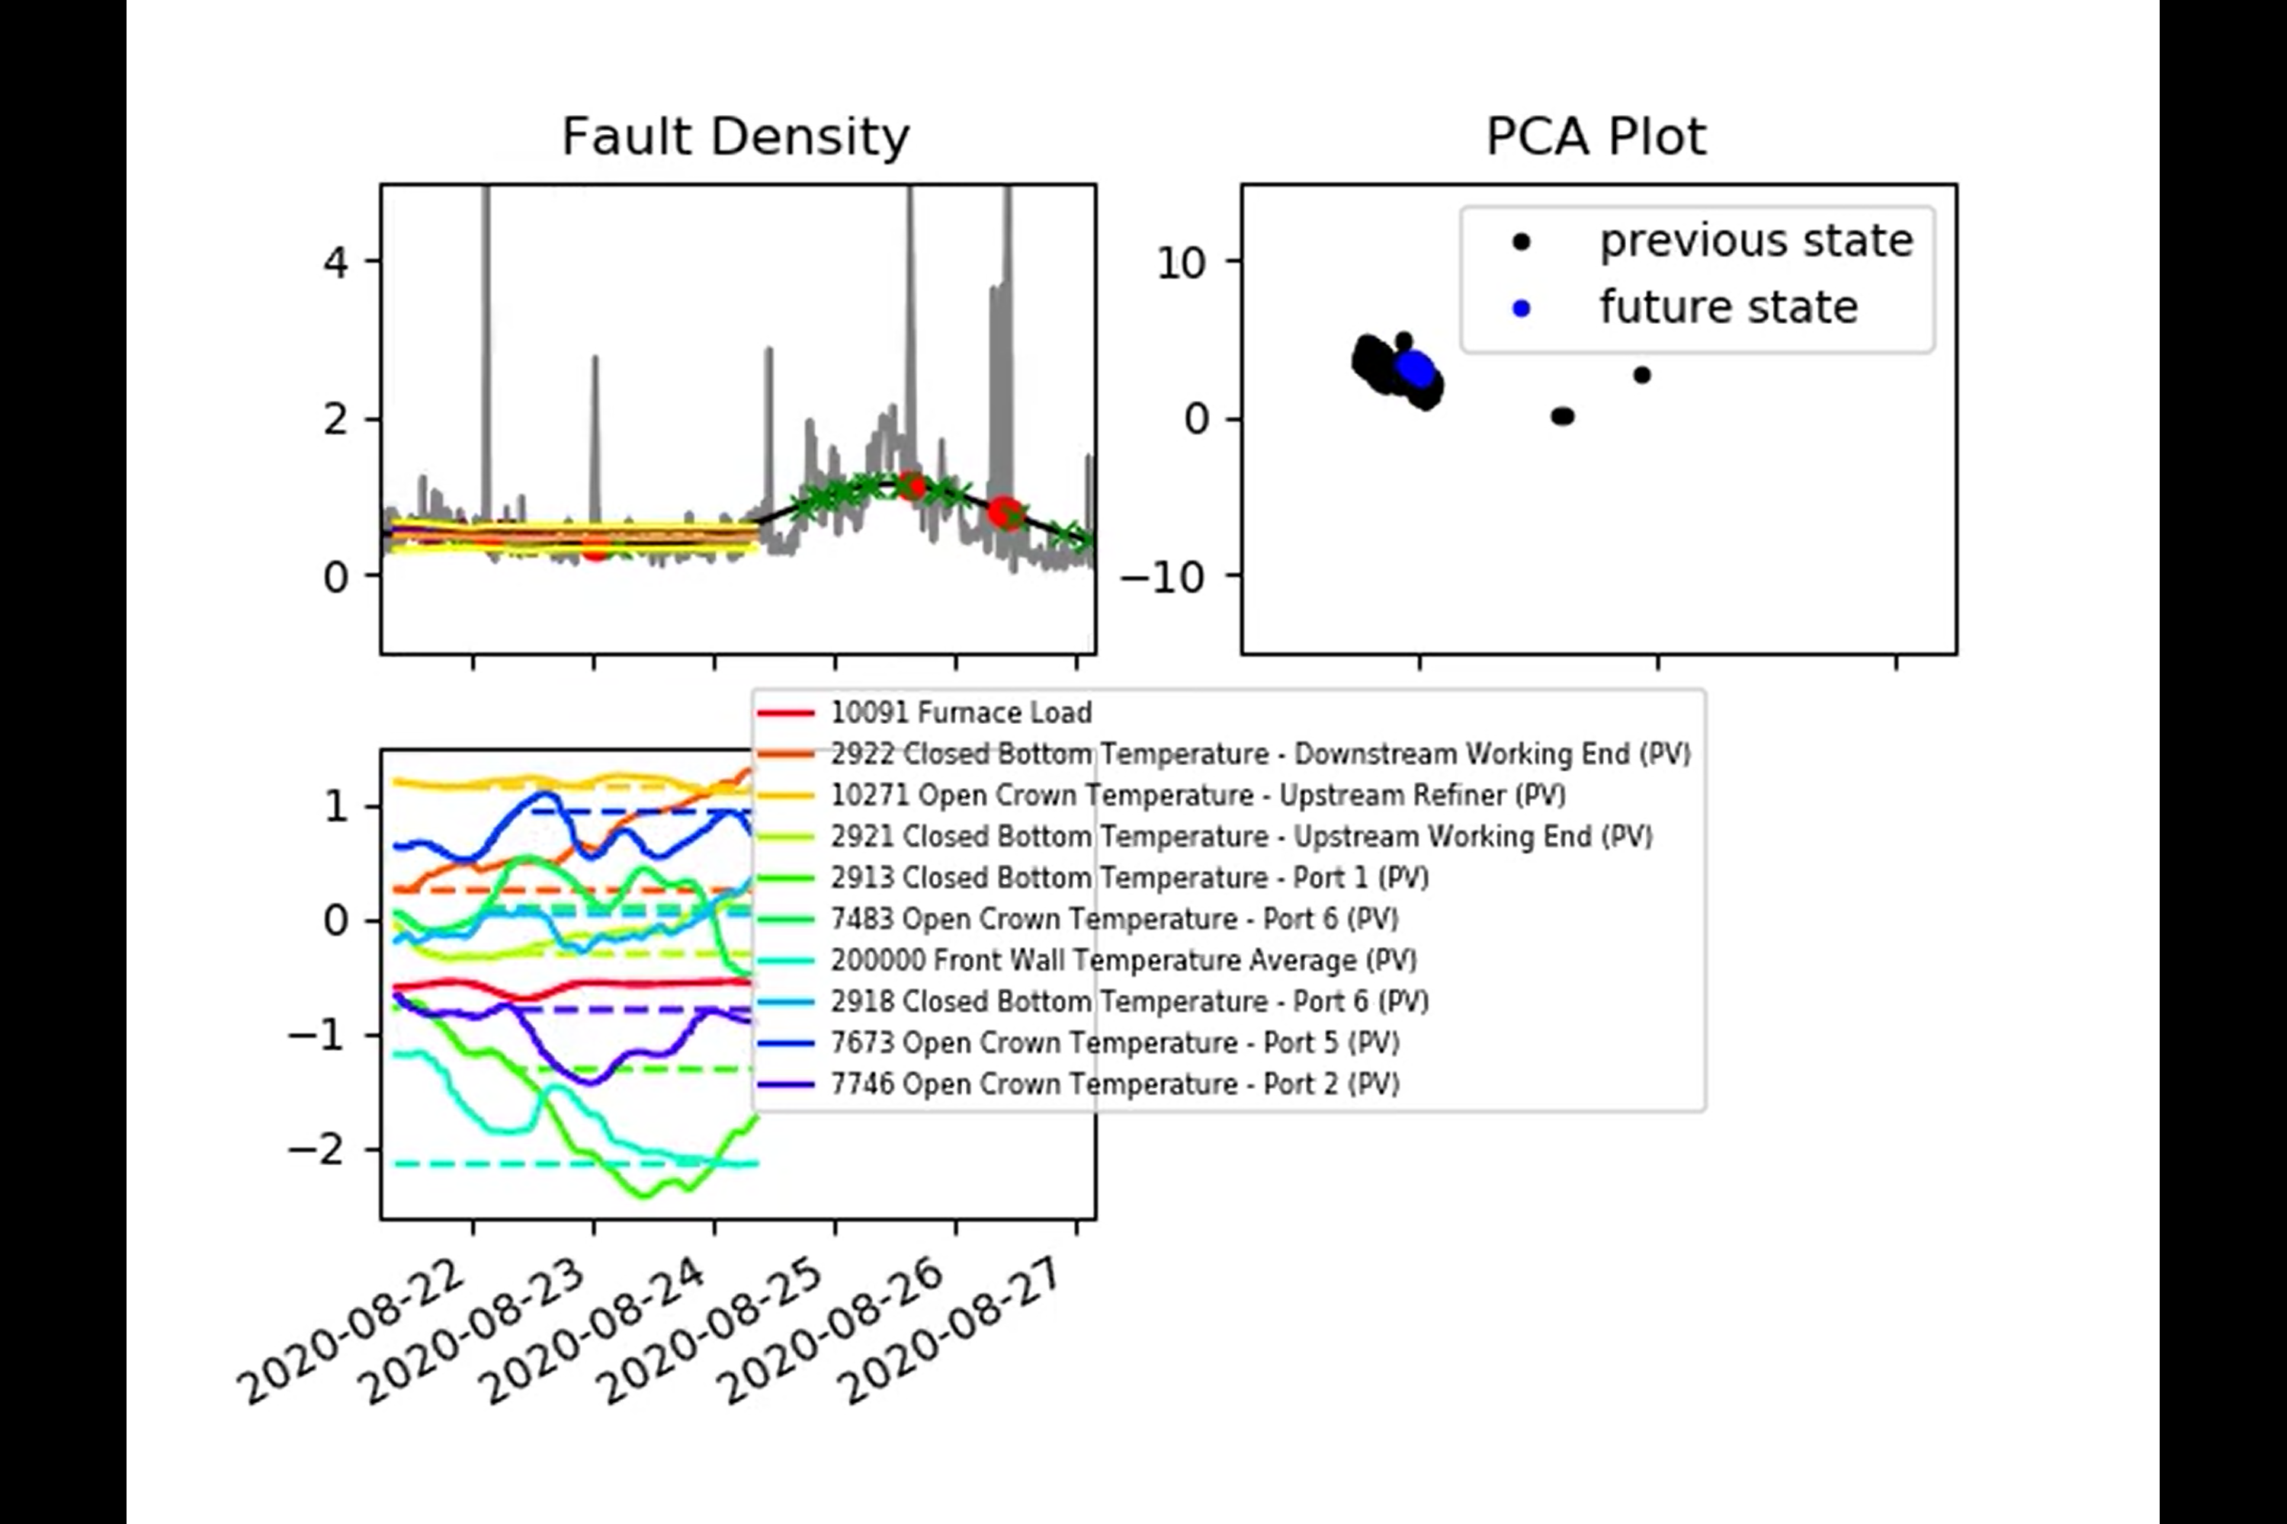
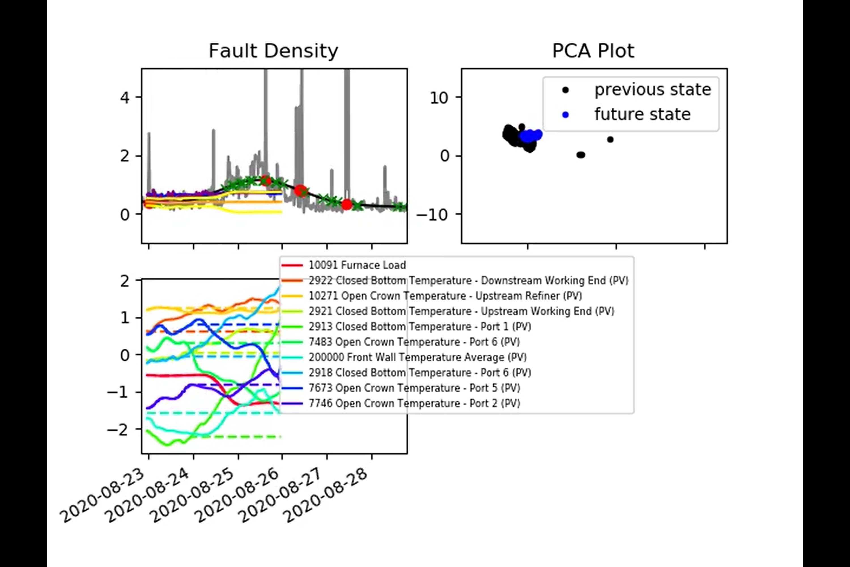
Predictions with Uncertain Inputs

Slide 9
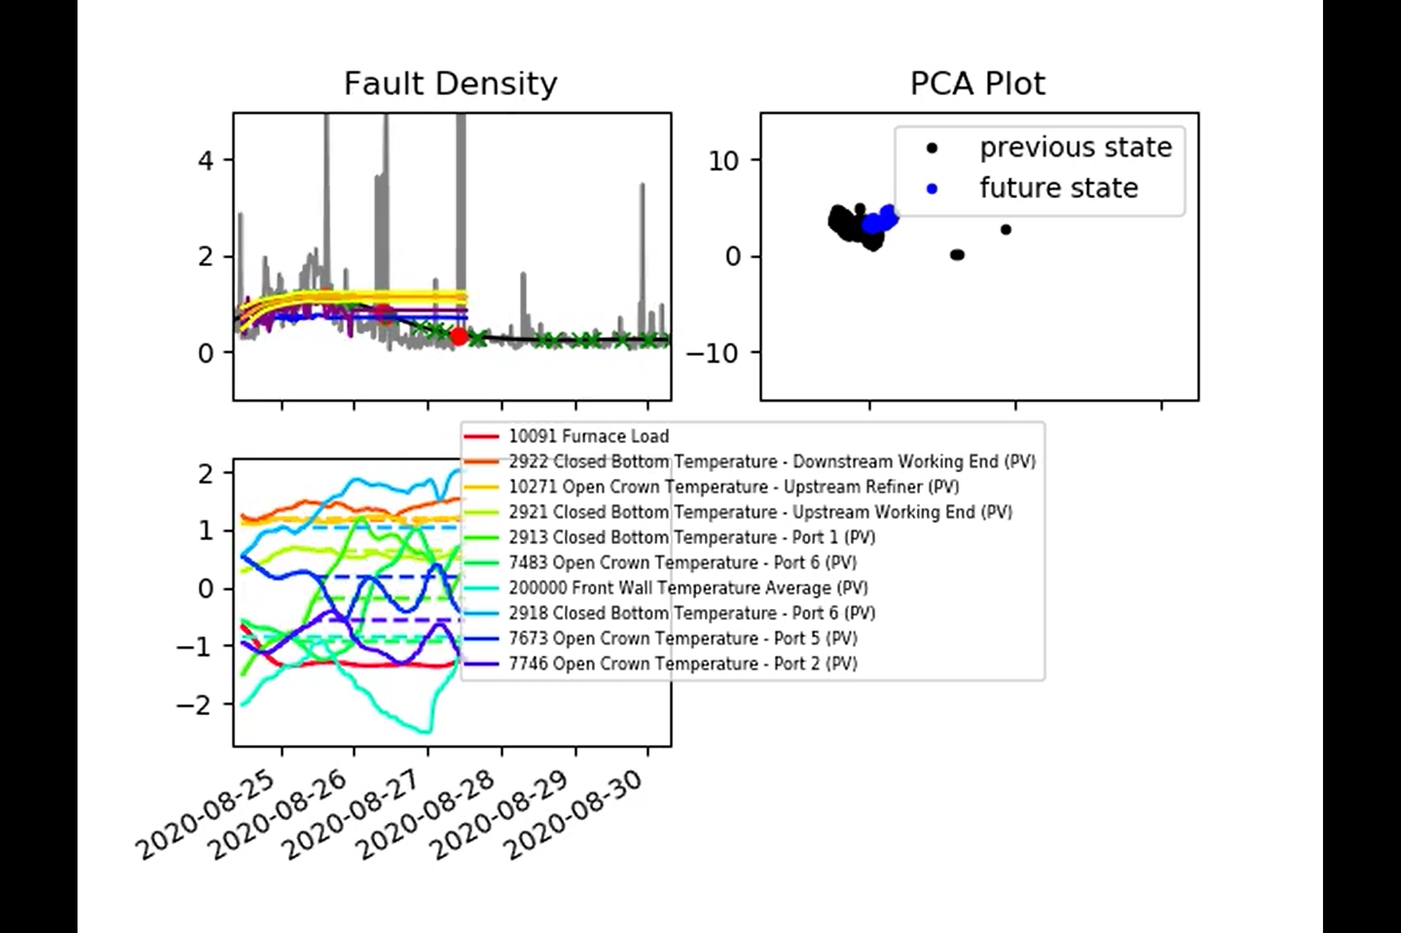
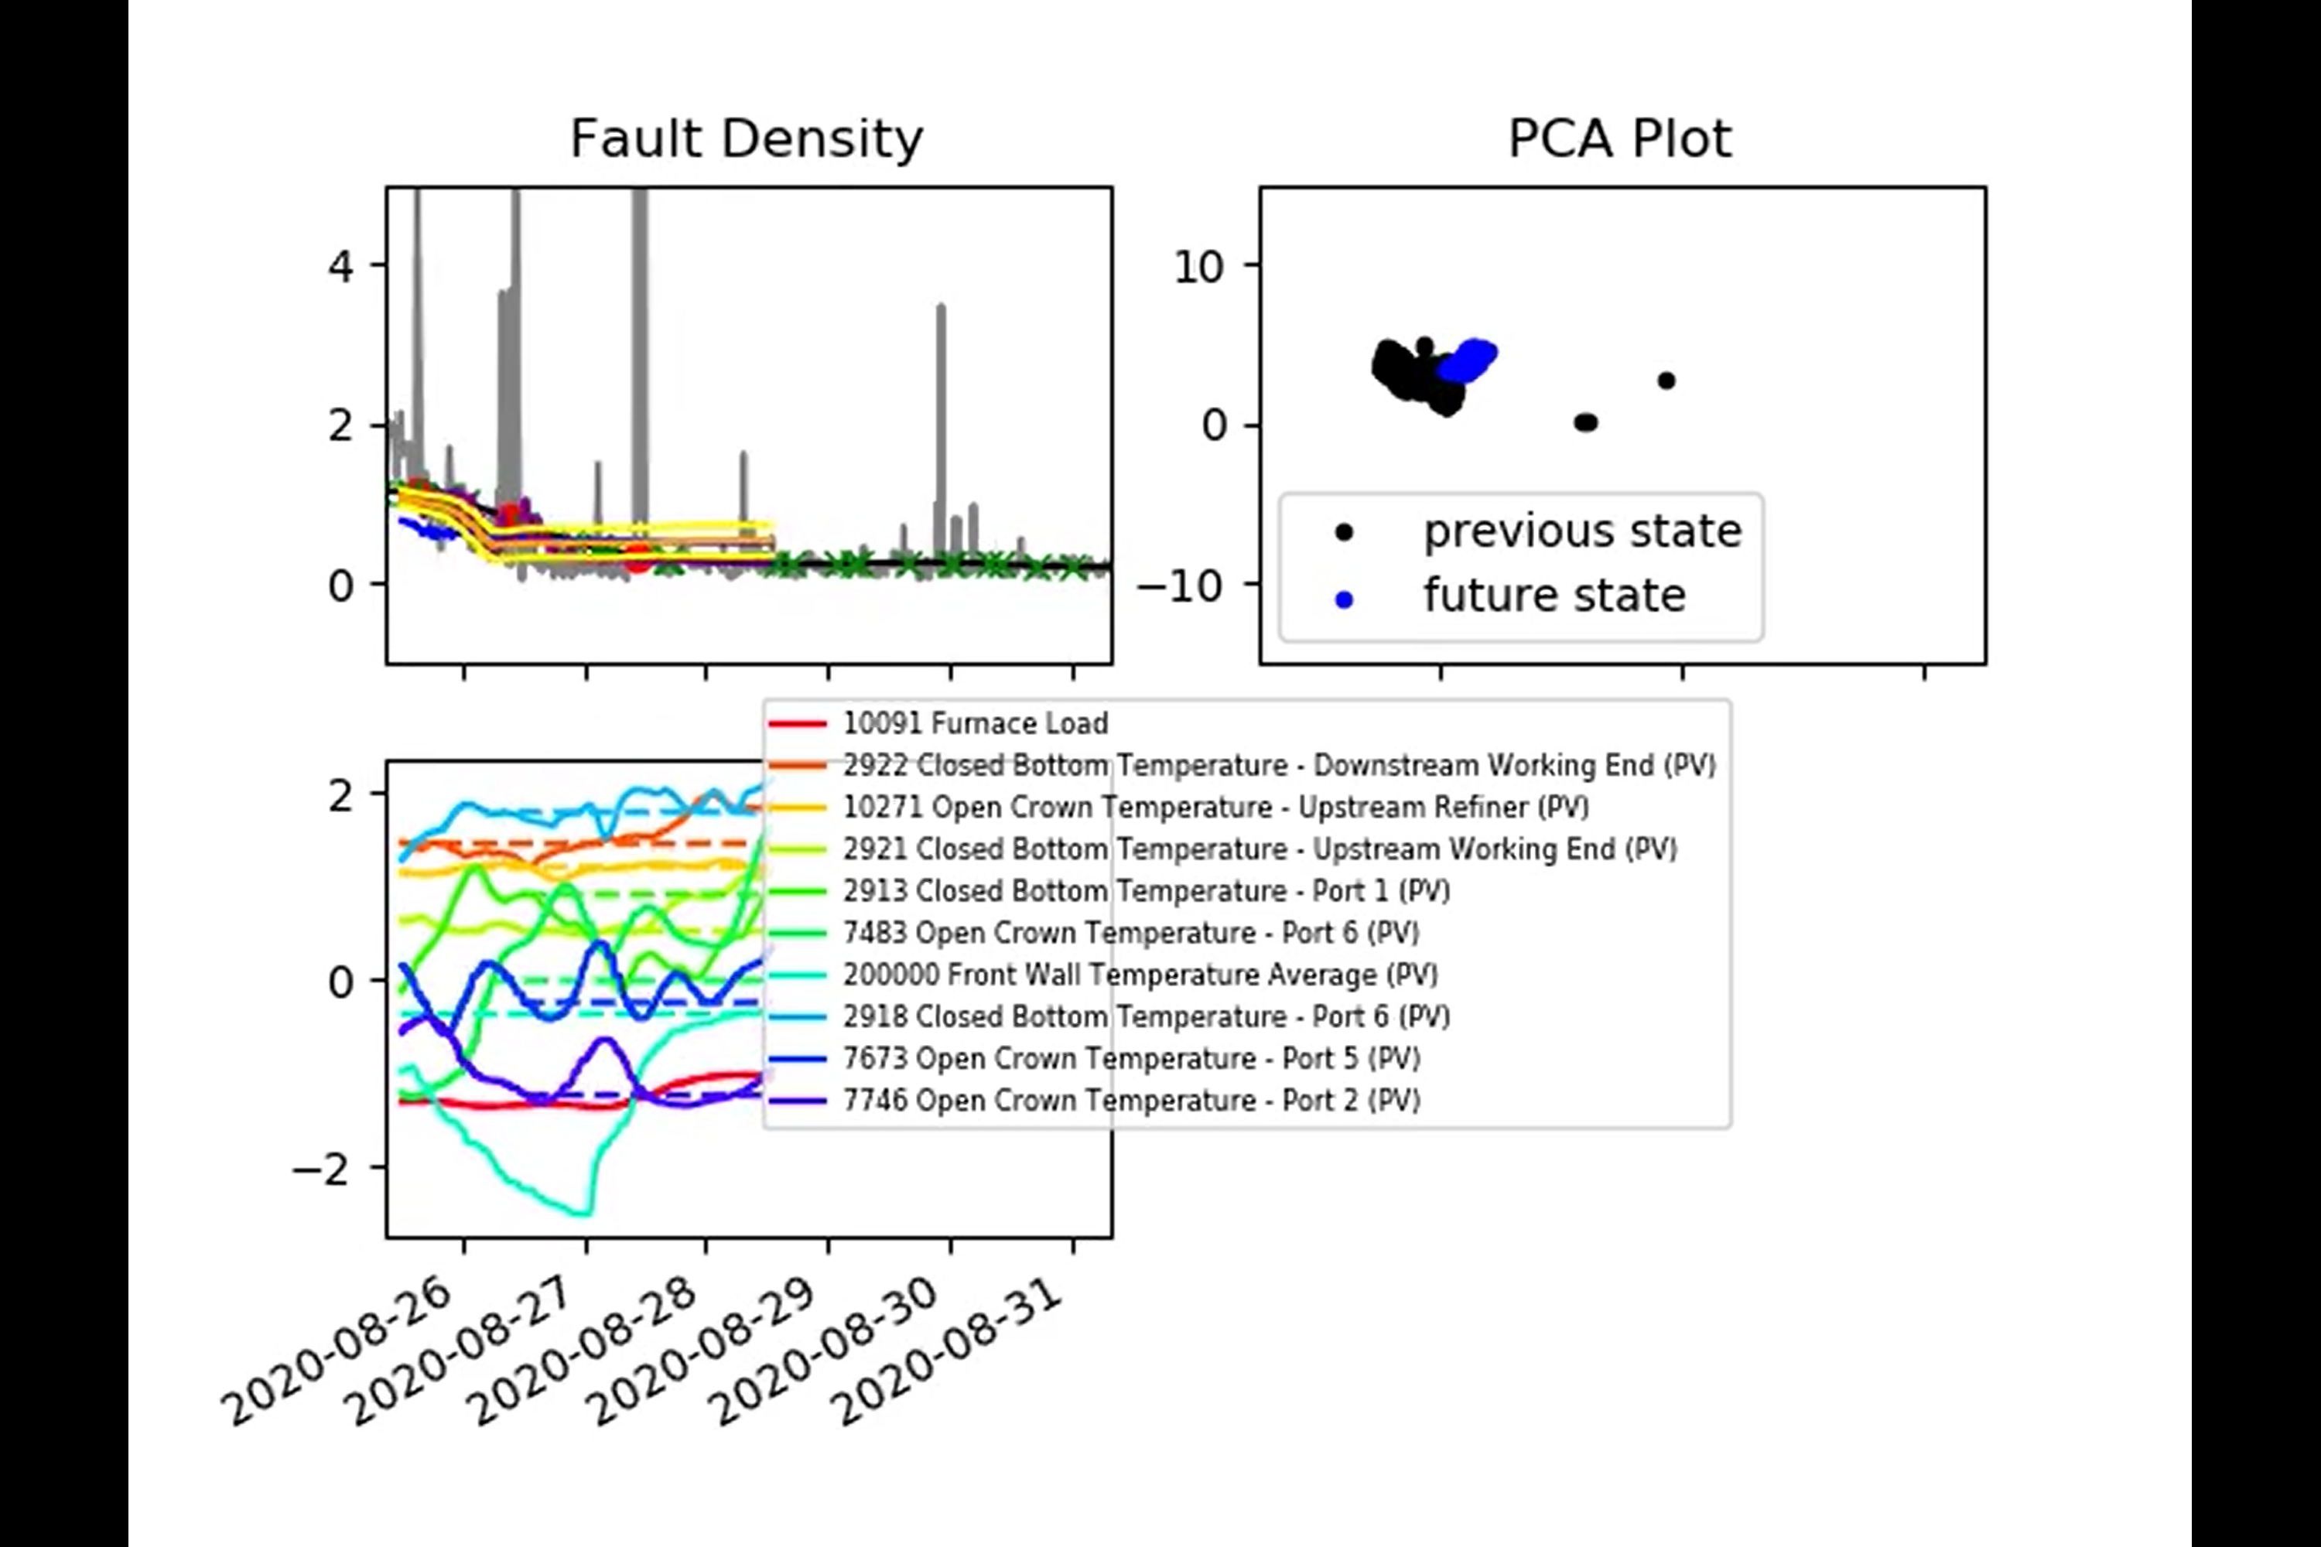
Predictions with Uncertain Inputs

Slide 10
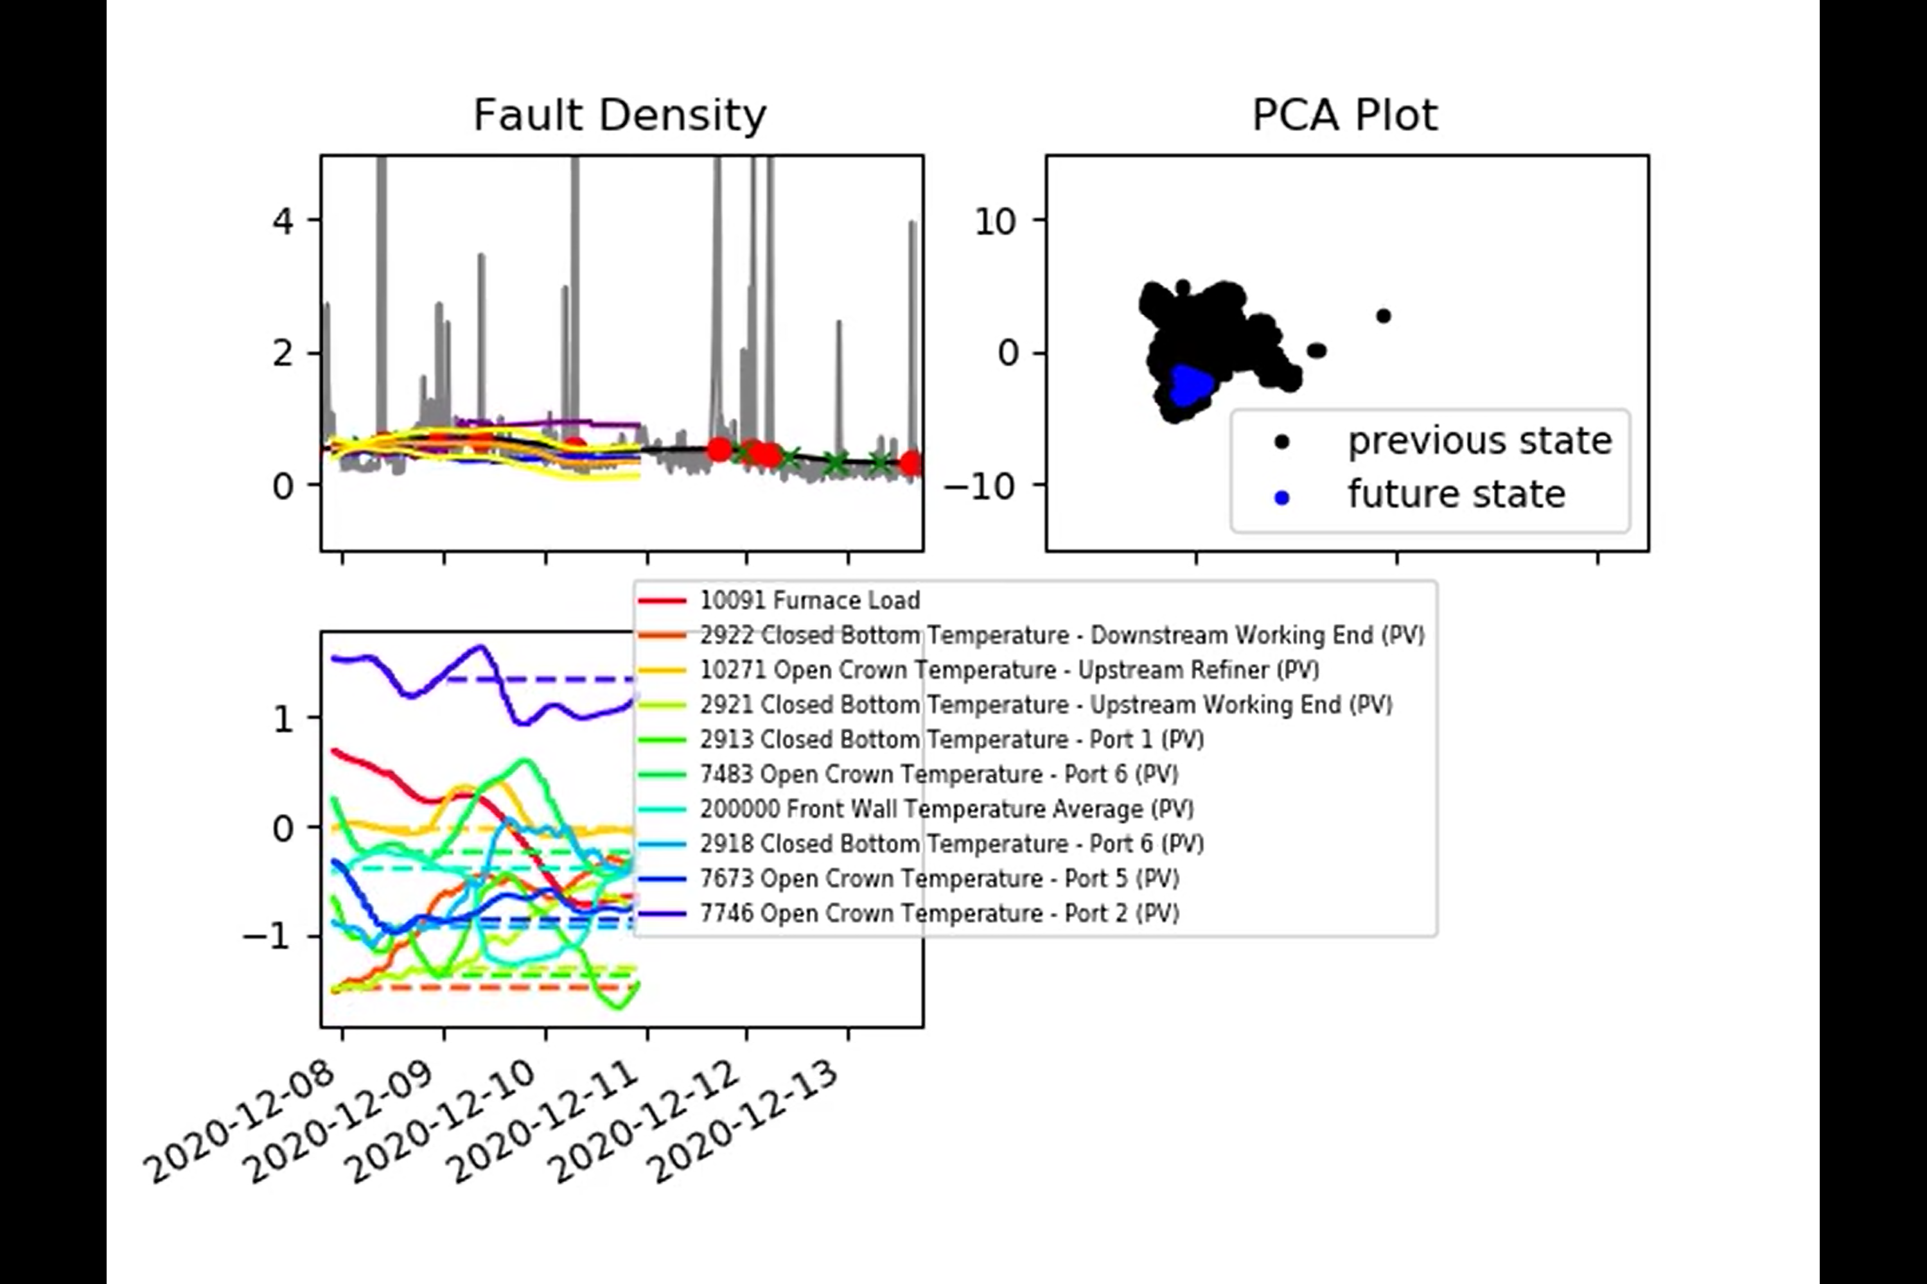
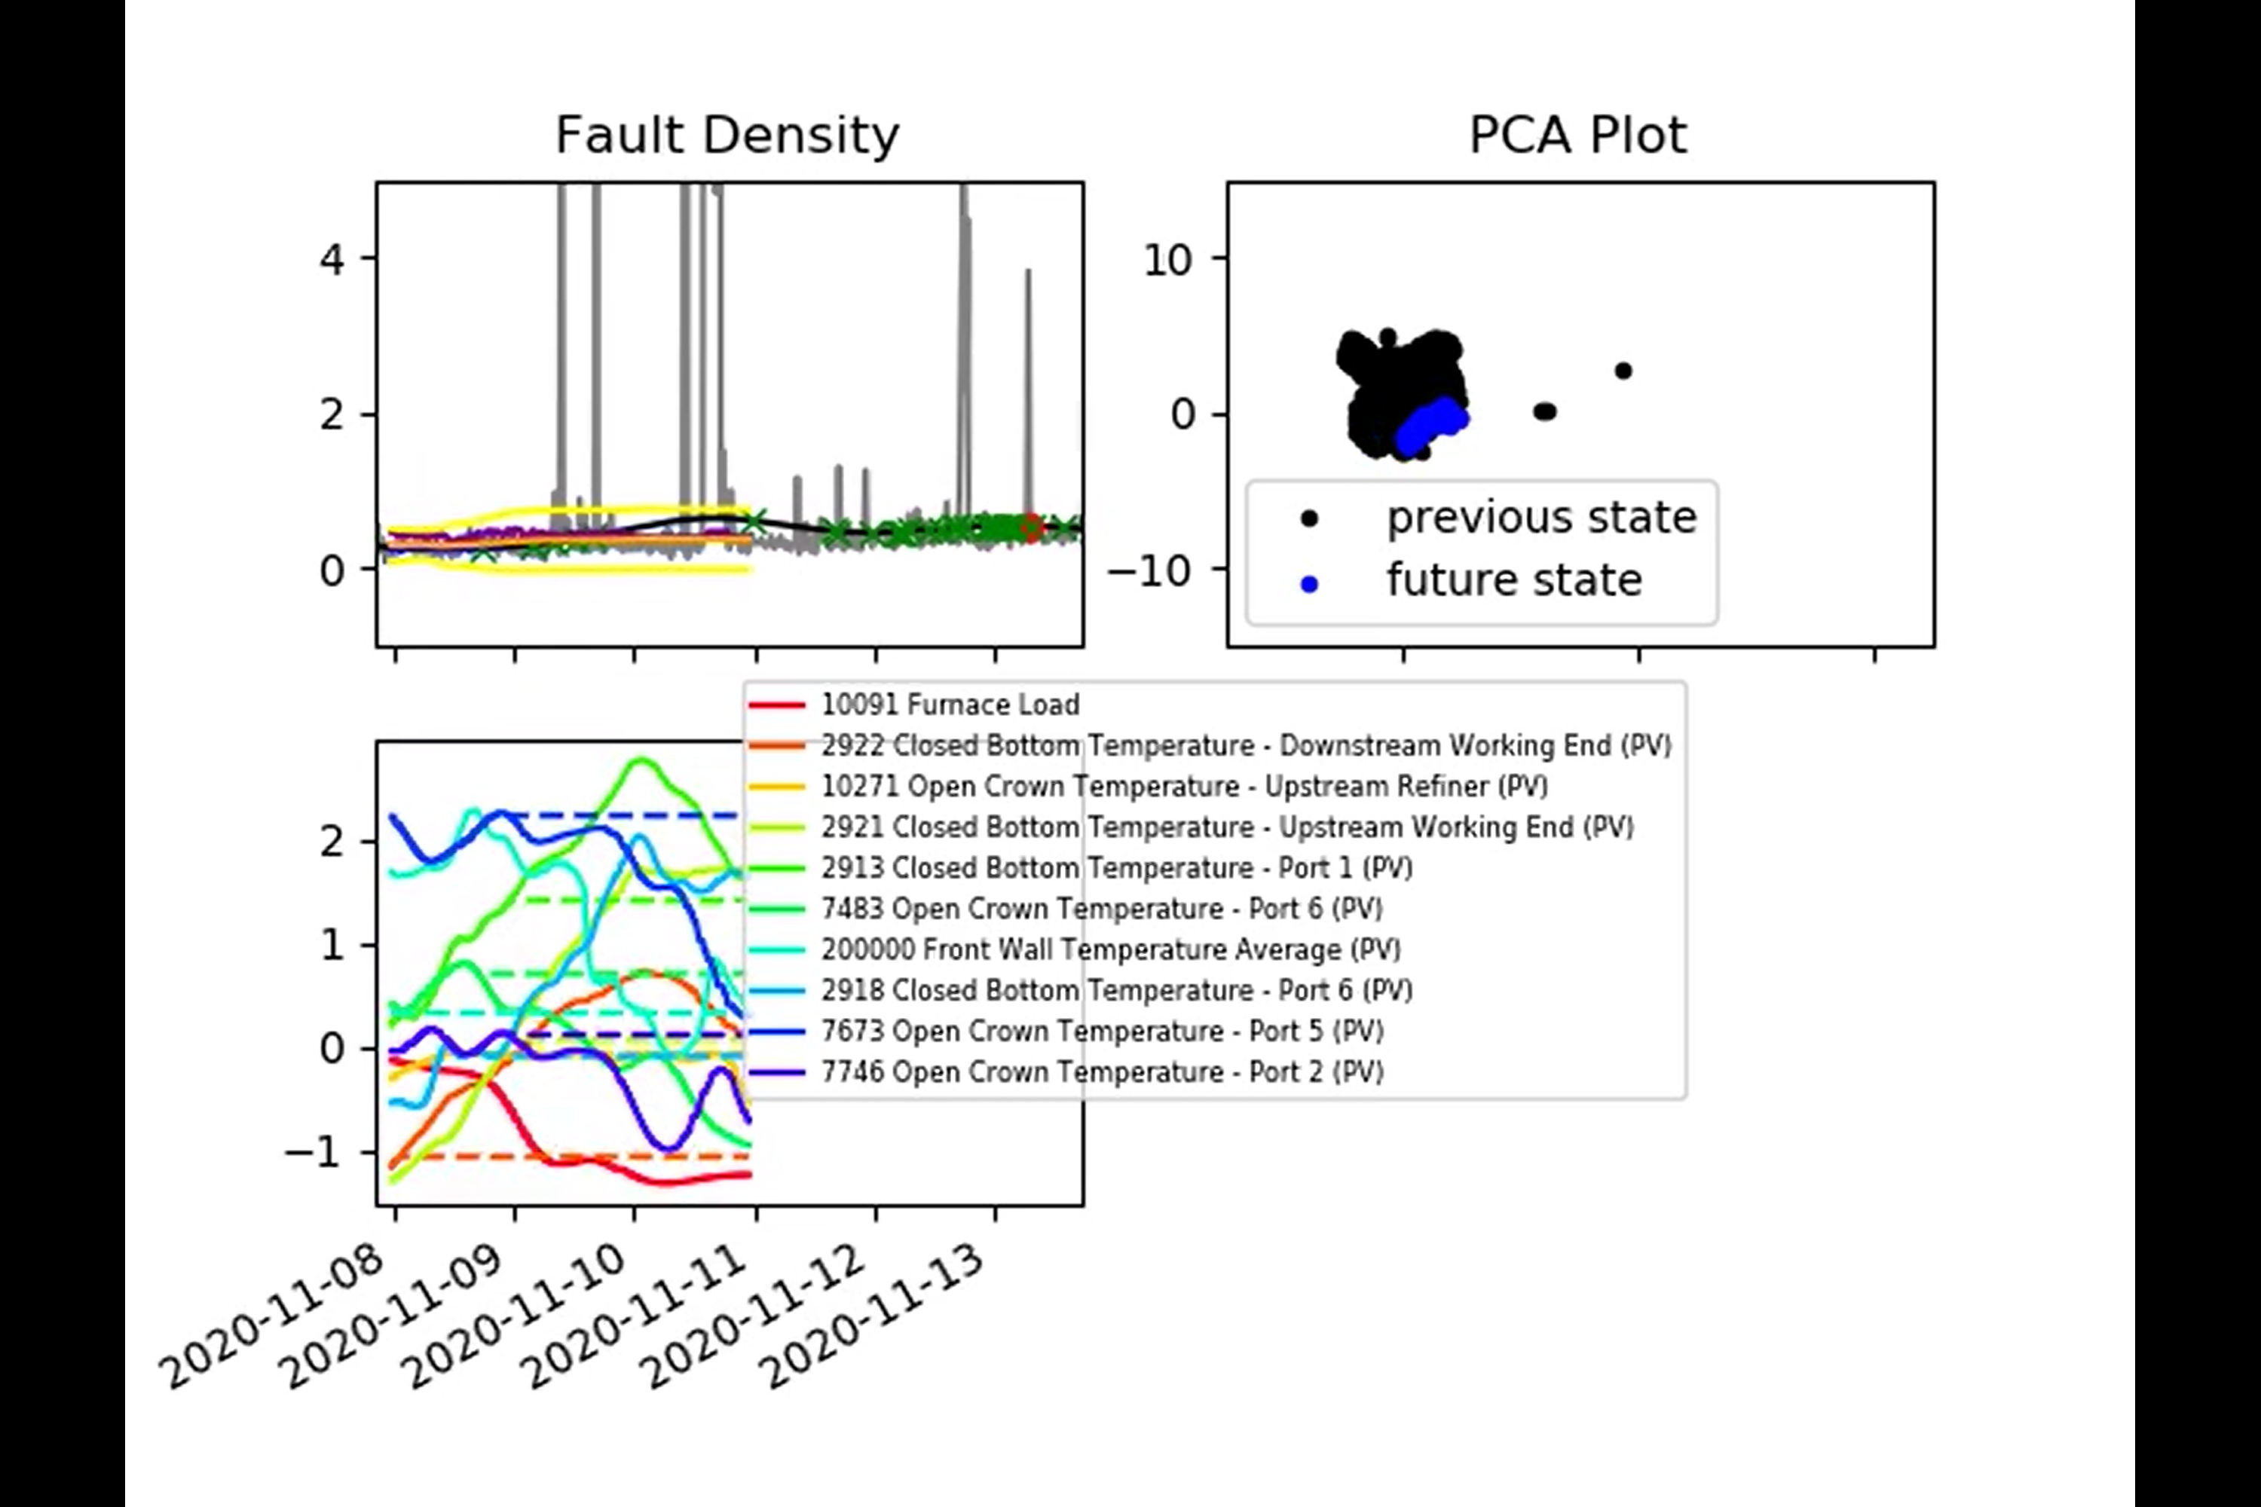
Predictions with Uncertain Inputs

Slide 11
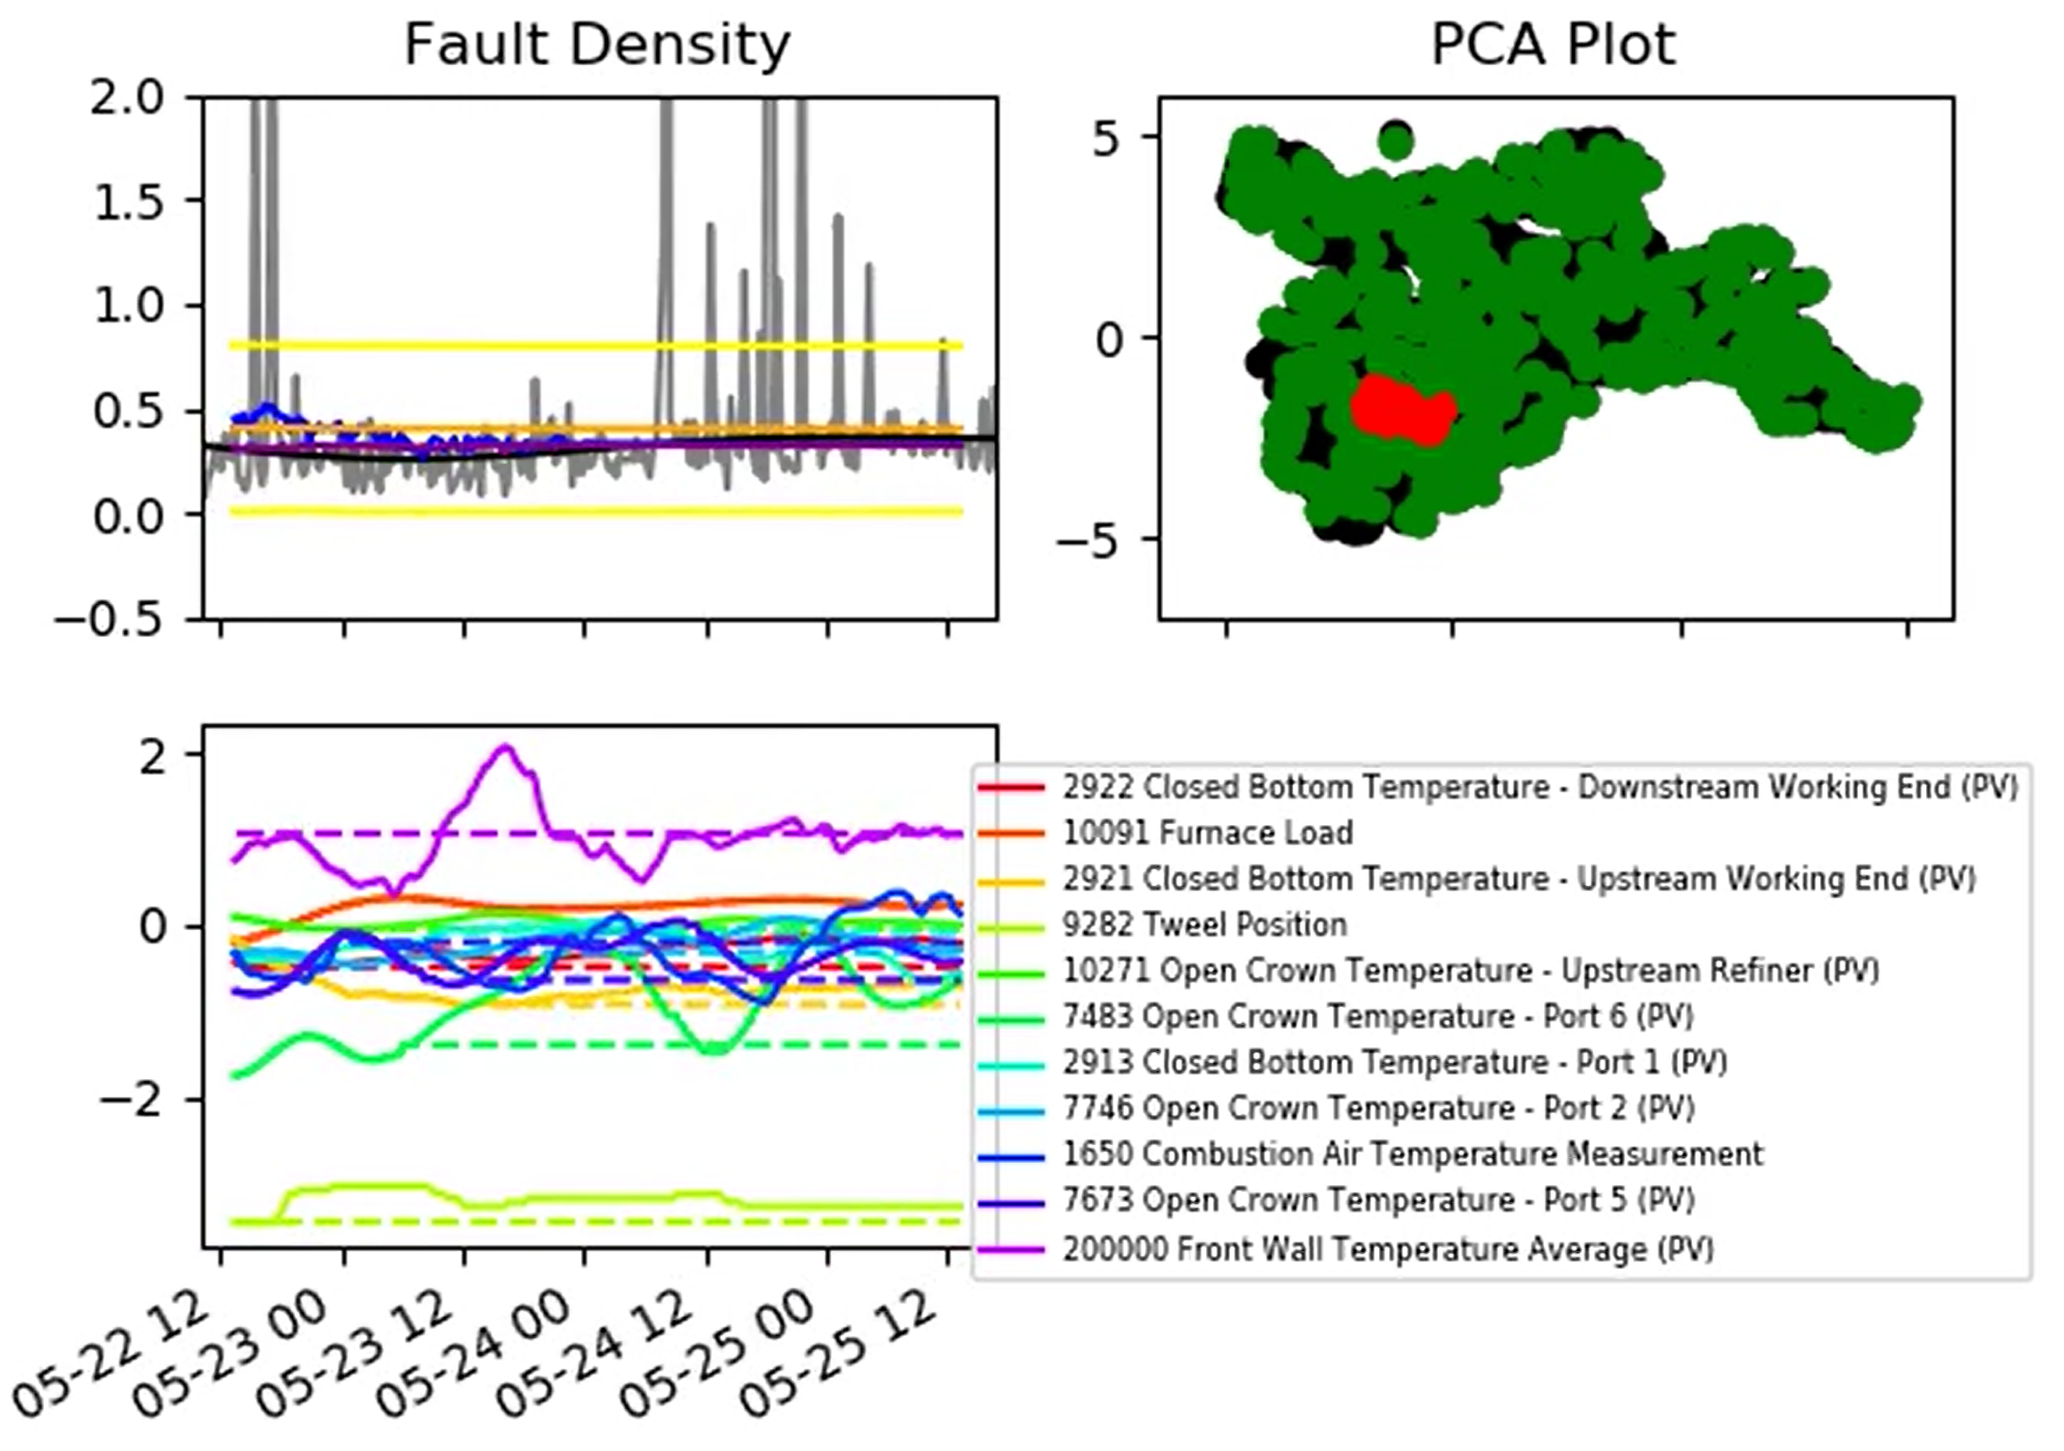
Predictions with Uncertain Inputs
The performance of the GP may improve if low-relevance inputs are removed, but the neural network performs well here. It is worth investigating if we can improve the GP for this dataset.
Are we surprised that this input keeps coming up?
It’s time lag is currently set to zero, so all future values are simply set equal to the current value.

Slide 12
Predictions with Uncertain Inputs
Overall, the results look promising.
Even if a rise is initially missed, the possibility of a rise is usually captured by an expansion of the confidence bounds.
It helps that Furnace Load is the among the most ‘important’ inputs.
Currently the ‘future points’ on the PCA plot represents the true furnace state – we can change this to reflect the projected furnace state?
Predictions outside of the training data – with the GP we could provide additional information detailing specifically which inputs have moved outside of the ‘training space’.
The following to be uploaded to the Sharepoint:
2021-06-29_results.mp4
2021-06-29_test_results

Slide 13
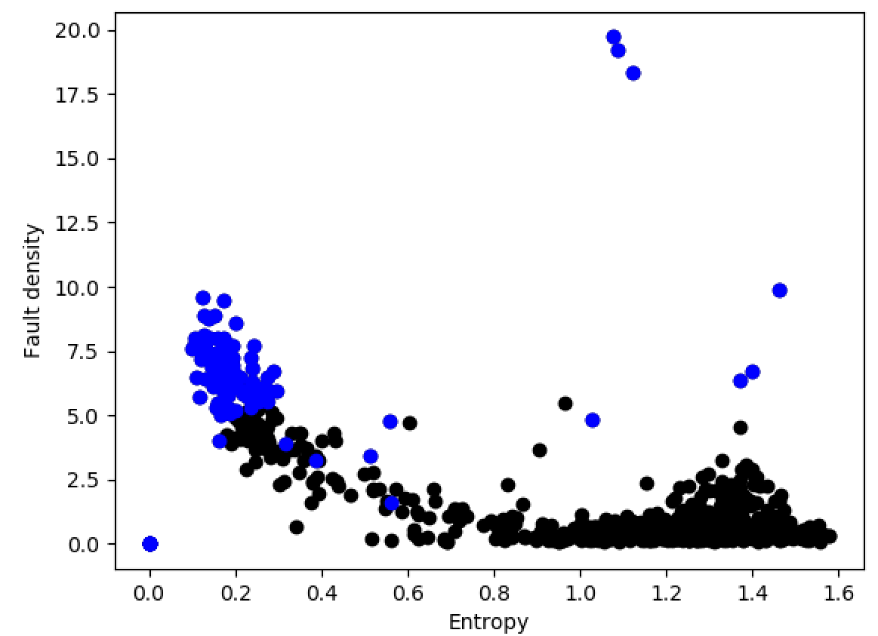
ISRA 5D
If we choose points where total fault density > 5 we could risk mistakenly replacing accurate module values

Slide 14
ISRA 5D
Therefore applying initial boundary conditions total fault density > 5 and entropy < 0.6.

Slide 15
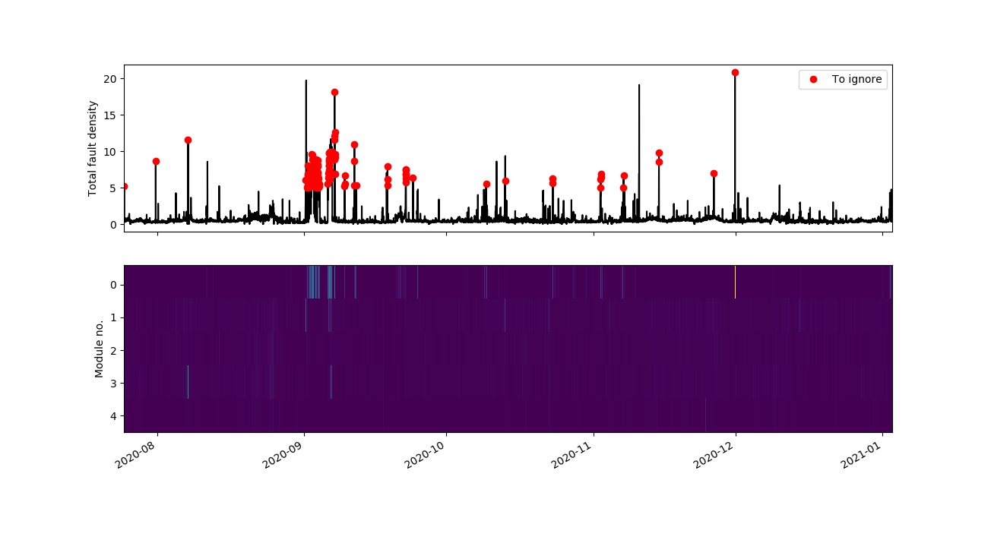
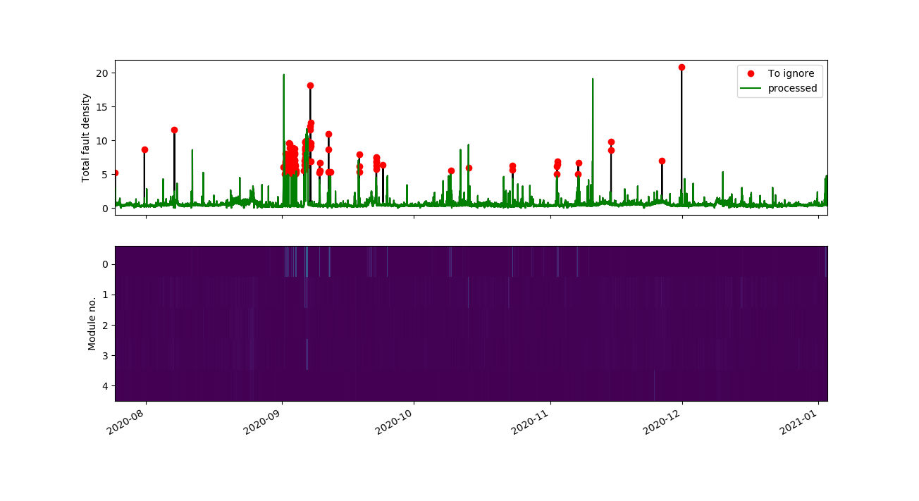
ISRA 5D
After identifying points ‘to ignore’ readings from the offending module has been replaced with the average across the remaining modules

Slide 16
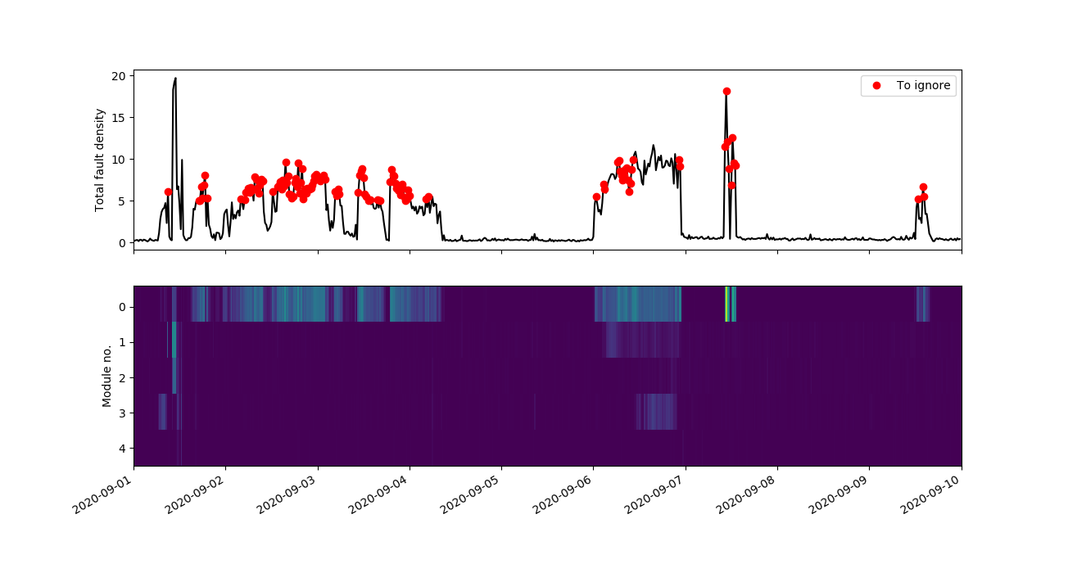
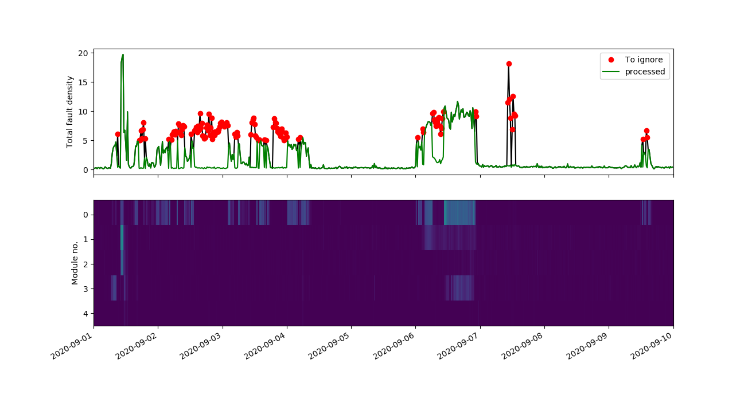
ISRA 5D
Are these coating related or not?

Slide 17
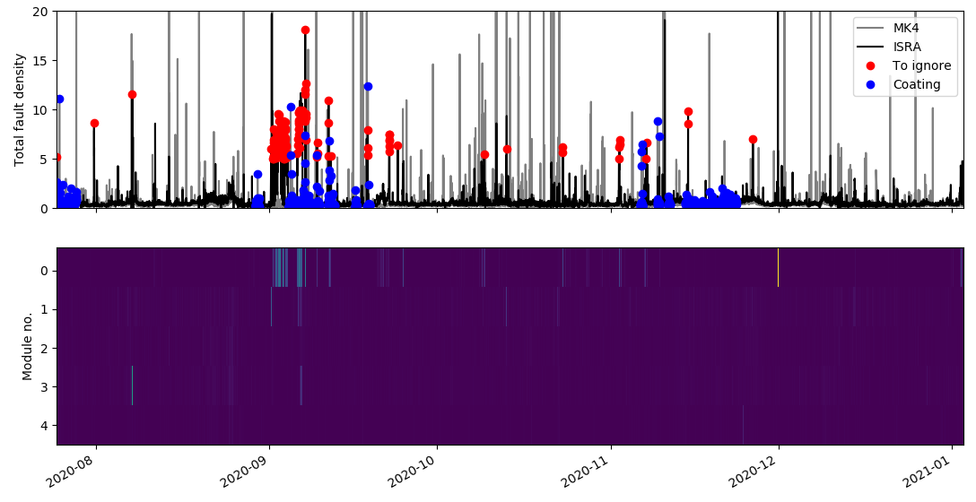
ISRA 5D
Identified points to ignore dose not match with coating periods identified by '7532 Exit End Pyrometer Temperature Centre (PV)'

Slide 18
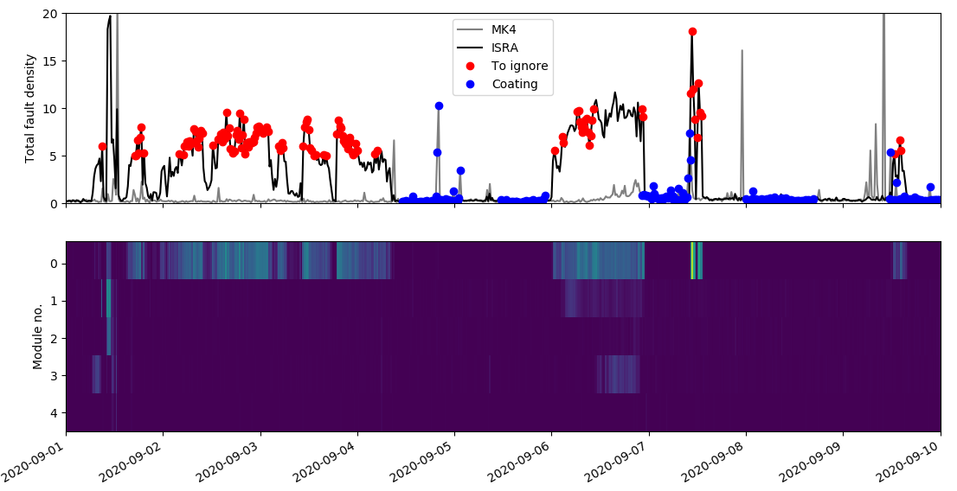
ISRA 5D

Slide 19
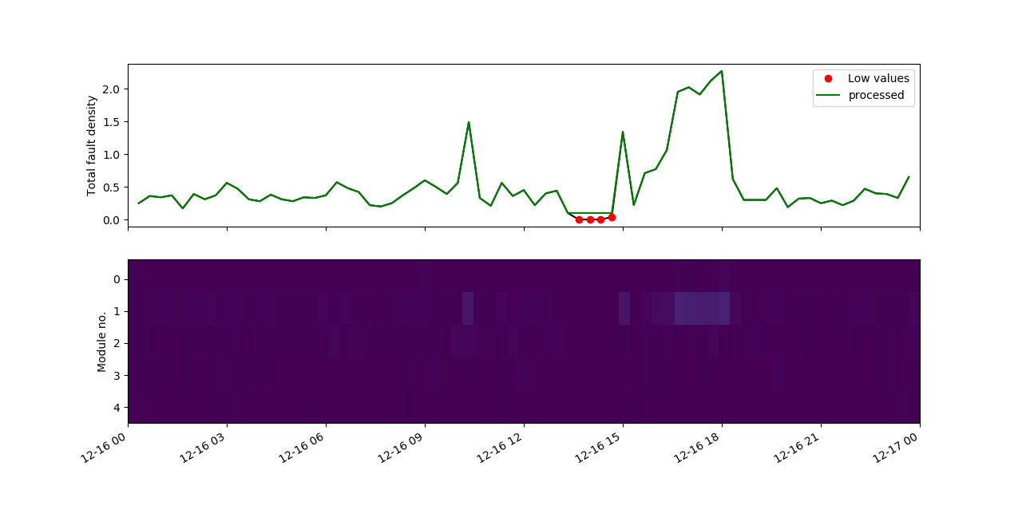
ISRA 5D
As agreed in the last meeting:
Even if the faults are uniformly low, we processed the points < 0.05 using the previous value.

Slide 20
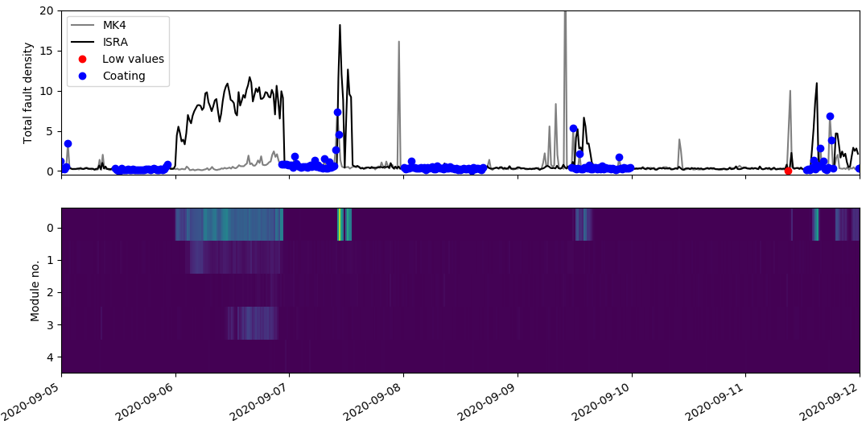
ISRA 5D: Low values at the coating region

Slide 21
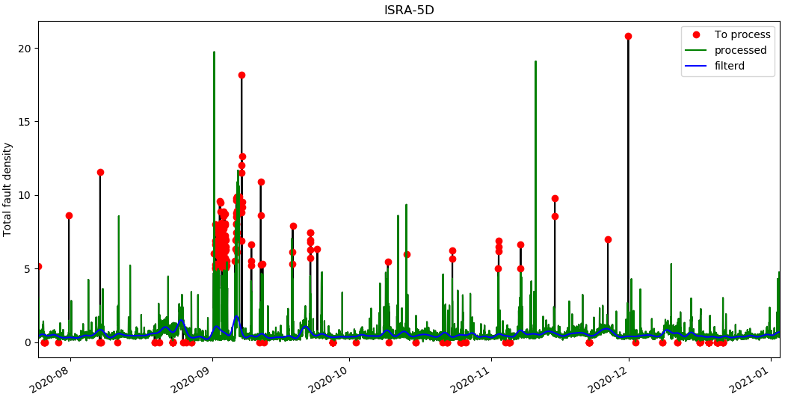
ISRA 5D

Slide 22
ISRA 5D
Total number of points = 11663
Number of high values processed = 155 Percentage = 1.32 %
Number of low values processed = 87 Percentage = 0.74 %
Number of processed elements = 242 Percentage = 2.07 %

Slide 23
Next Steps
Timing
Pete away 5th – 18th July
Currently no RA funding beyond August (but proposal has been submitted)
Key Challenges
Uncertain inputs (possibly addressed today)
ISRA data (mixtures of real and erroneous fault readings)
Interpretability
Do we want to pursue the mixture of linear experts or is the GP enough?
Other bits
With the GP, if we are outside of the training data, we could also report specifically which inputs this relates to
The GP may perform better on the test data if low-relevance inputs are removed
Tuning time lags – needs a lot of runtime but shouldn’t be too challenging
Long term
Furnace AI report
Upskilling

Slide 24
Thank you for your attention. ANY QUESTIONS?

